Slide 1


Slide 2

Tutorial 9 Sections 009/010
TA: Greydon Gilmore
Physiology 2130
Nov 12th, 2019

Slide 3

Your TA reminding you…
2nd Peerwise assignment (1.5%)
Post 2 MC questions: due Nov 27th @ midnight
Answer 5 MC questions: due Nov 29th @ midnight
2nd Quiz (1%)
Opens: Dec 2nd @ 4pm
Closes: Dec 3rd @ 4pm
2nd Midterm (15%)
When: Dec 19th @ 9am-10am
Room Assignments:
ABBA-GANE: Alumni Hall 15
GHAB-POSA: Alumni Hall 201
PRIM-WOOD: Alumni Hall Stage
WU-ZIA: Somerville House 2316
Same place!

Slide 4
Today
Group work activity
Midterm Review
Learning Catalytics Question
Autonomic nervous system
Muscle anatomy

Slide 5
Suggestion Box Questions

Slide 6
Explain what reproductive organs do in both parasympathetic and sympathetic. How do they work together? What do they influence and what type of reaction happens once they are activated?

Slide 7
Explain what reproductive organs do in both parasympathetic and sympathetic. How do they work together? What do they influence and what type of reaction happens once they are activated?
Cooperative effect: sexual function
PNS
Males: induces erection
Females: engorgement and secretions
SNS
Males: Induces ejaculation
Females: stimulates contraction
Complimentary effect: saliva production
PNS → stimulate water and enzymes
SNS → stimulate thick mucous

Slide 8
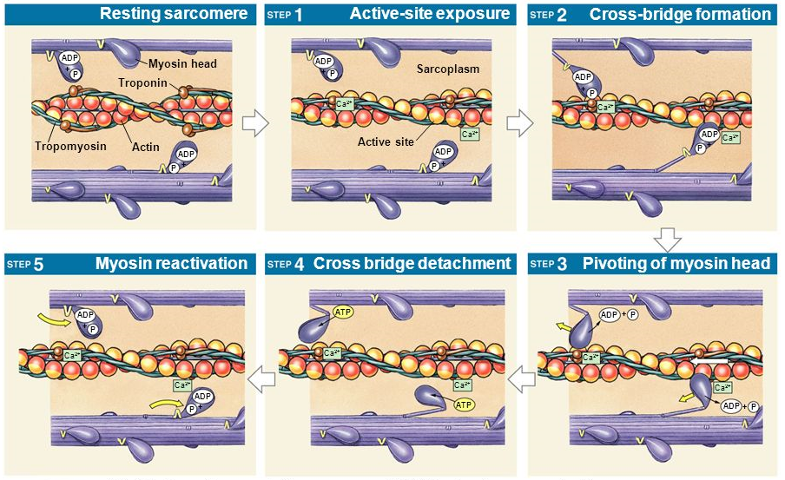
Explain the Sliding Filament Theory and how a crossbridge forms. Also, I'm not really sure what a crossbridge is and what happens after that. Thanks
Ca²⁺ binds troponin, causes tropomyosin to roll off and expose myosin binding site
Myosin head binds actin binding site, cross-bridge formation
P_{i} released from myosin head causing power stroke (muscle contraction)
ADP released, myosin still bound to actin until new ATP attached, myosin head detaches (cross-bridge broken)
ATP hydrolyzed to ADP + P_{i}
Cross-bridge is the connection of myosin head to actin (once binding site is clear). Cross-bridge will allow power stroke to occur (muscle contraction)

Slide 9
Group Work

Slide 10

Play-DOH!
Out of Play-DOH, construct a model of a myofilament, containing both thin and thick myofilaments. Use your notes from Prof. Stavraky’s first muscle lecture and your workbook to reconstruct a 3D version of these filaments and show how the two can bind to each other. Place your model on a piece of paper and indicate with labels the different structures (ie. Troponin, G-actin, ATP binding site etc.). Take a picture and upload.

Slide 11
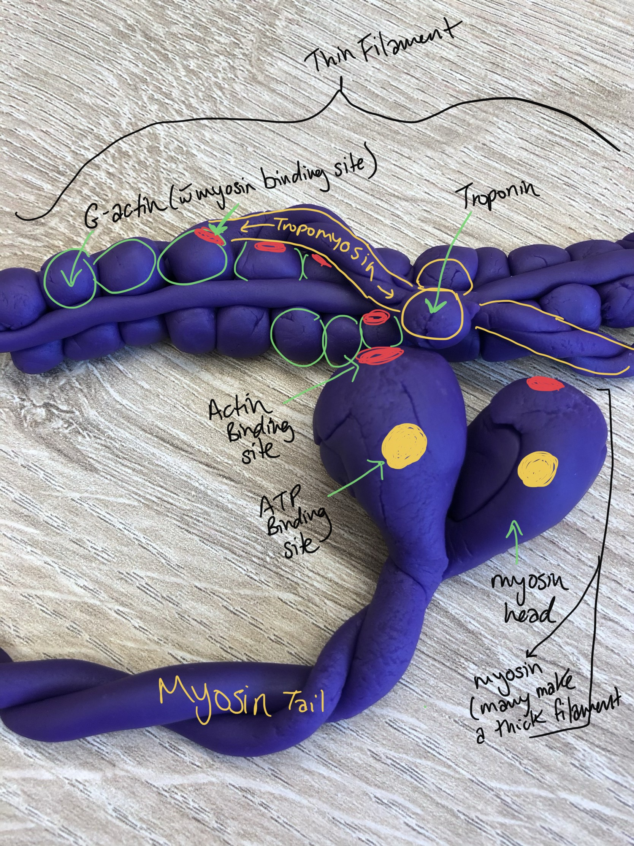
Example

Slide 12
Learning Catalytic Question

Slide 13
Midterm Question Take-up

Slide 14
Q11: Compared to a weaker mechanical stimulus, which of the following statements best describes the effect of a stronger mechanical stimulus on a mechanoreceptor?
the neuron gets more hyperpolarized
the amplitude of action potentials increases
more neurotransmitter is released
the velocity of action potentials increases

Slide 15
Q11: Compared to a weaker mechanical stimulus, which of the following statements best describes the effect of a stronger mechanical stimulus on a mechanoreceptor?
the neuron gets more hyperpolarized
the amplitude of action potentials increases
more neurotransmitter is released
the velocity of action potentials increases
Velocity and amplitude never change (all or none), however more action potentials can be propagated leading to more neurotransmitter

Slide 16
Q12: Which statement is INCORRECT about special senses receptors?
stimulation of the receptor alters their membrane potential
they release neurotransmitter
the special senses receptor generates action potentials
they project to primary sensory neurons

Slide 17
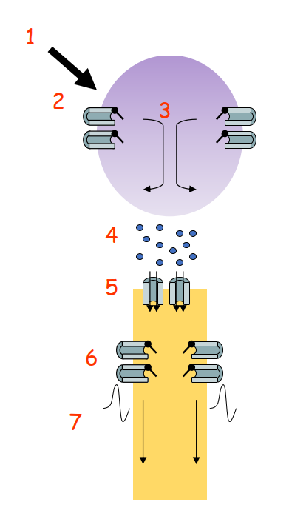
Q12: Which statement is INCORRECT about special senses receptors?
stimulation of the receptor alters their membrane potential
they release neurotransmitter
the special senses receptor generates action potentials
they project to primary sensory neurons
Special sense receptors produce receptor potential, which release neurotransmitter onto primary sensory neurons
Sensory lecture #1

Slide 18
Q14: Which of the following sensory neurons provides the smallest two-point discrimination?
a secondary sensory neuron that receives inputs from few primary neurons with small receptive fields
a secondary sensory neuron that receives inputs from many primary neurons with small receptive fields
a secondary sensory neuron that receives inputs from many primary neurons with small receptive fields
a secondary sensory neuron that receives inputs from few primary neurons with large receptive fields

Slide 19
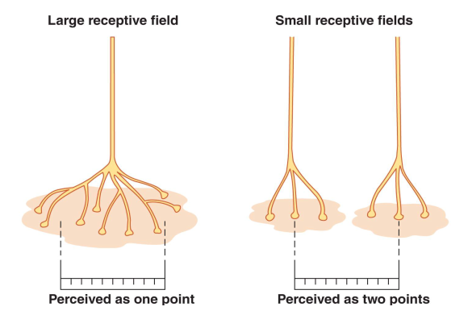
Q14: Which of the following sensory neurons provides the smallest two-point discrimination?
a secondary sensory neuron that receives inputs from few primary neurons with small receptive fields
a secondary sensory neuron that receives inputs from many primary neurons with small receptive fields
a secondary sensory neuron that receives inputs from many primary neurons with small receptive fields
a secondary sensory neuron that receives inputs from few primary neurons with large receptive fields

Slide 20
Q20: How is the frequency of sound encoded in the cochlea?
hair cells release more neurotransmitter for higher frequencies
different hair cells are activated by different frequencies
additional hair cells are activated for higher frequencies
hair cells fire more action potentials for higher frequencies

Slide 21
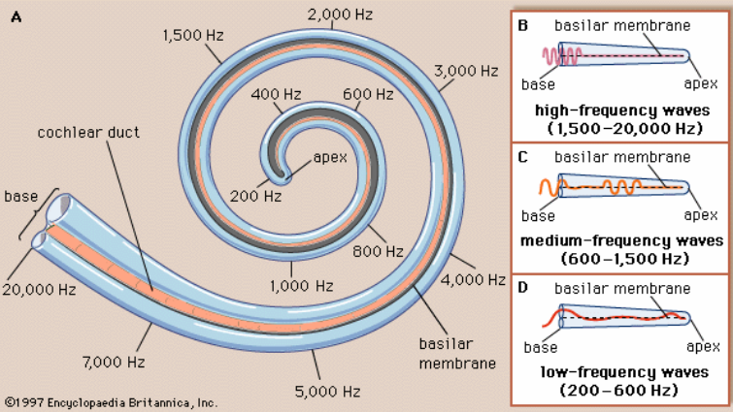
Q20: How is the frequency of sound encoded in the cochlea?
hair cells release more neurotransmitter for higher frequencies
different hair cells are activated by different frequencies
additional hair cells are activated for higher frequencies
hair cells fire more action potentials for higher frequencies
Depending on the frequency different hair cells will be activated along the basilar membrane

Slide 22
Q21: In which part of the auditory system do we NOT find tonotopy?
in the auditory cortex
in the middle ear
in the cochlear
in the auditory thalamus

Slide 23
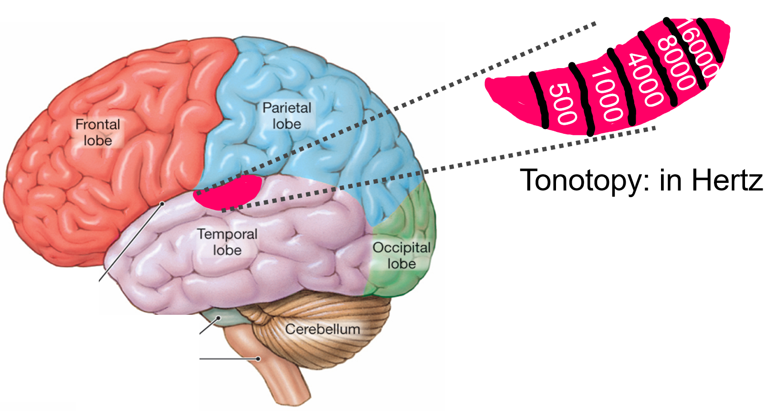
Q21: In which part of the auditory system do we NOT find tonotopy?
in the auditory cortex
in the middle ear
in the cochlear
in the auditory thalamus
Sensory lecture #4 slide 17: “Tonotopy is maintained throughout auditory system”

Slide 24
Q24: What happens when there is reduced dopaminergic input to the putamen?
activity in the globus pallidus external segment increases
activity in the globus pallidus internal segment decreases
activity in the subthalamic nucleus increases
activity in the thalamus increases

Slide 25
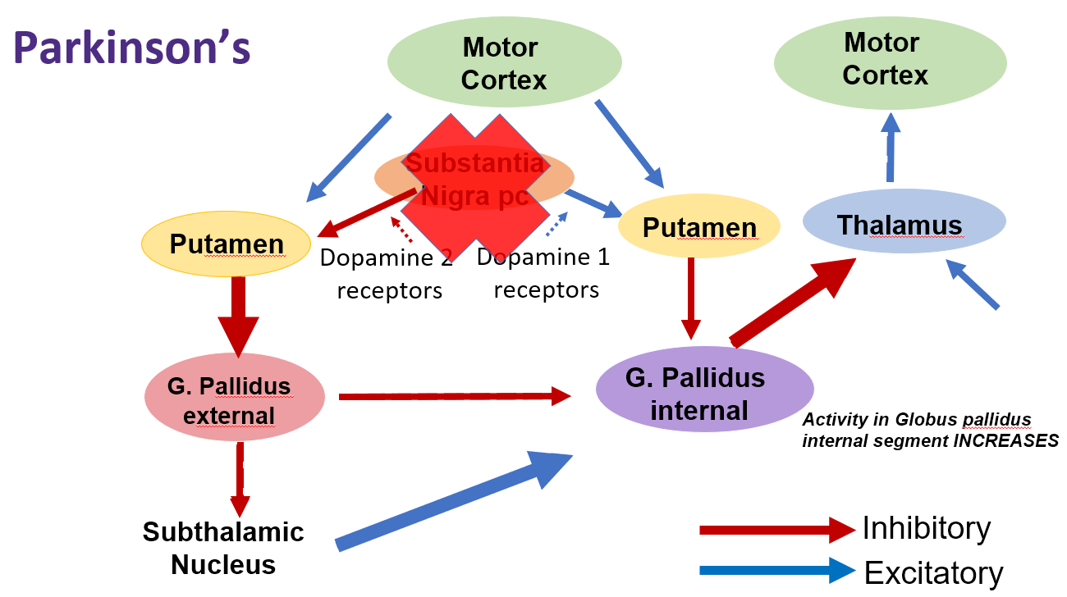
Q24: What happens when there is reduced dopaminergic input to the putamen?
activity in the globus pallidus external segment increases
activity in the globus pallidus internal segment decreases
activity in the subthalamic nucleus increases
activity in the thalamus increases

Slide 26
Q29: What is true about the anterior pituitary?
all of the hormones released by the hypothalamus that act on the anterior pituitary are considered releasing hormones → 94
all of the hormones released by the anterior pituitary gland are peptide/protein hormones → 103
the anterior pituitary gland is made up of neurons
the anterior pituitary gland secretes hormones that all cause secretion of hormones by other tissues/organs of the body

Slide 27
Q29: What is true about the anterior pituitary?
all of the hormones released by the hypothalamus that act on the anterior pituitary are considered releasing hormones
all of the hormones released by the anterior pituitary gland are peptide/protein hormones
the anterior pituitary gland is made up of neurons
the anterior pituitary gland secretes hormones that all cause secretion of hormones by other tissues/organs of the body
Remember Prolactin!

Slide 28
Q31: Which of the following would result in an increase in the permeability of the cell membrane to Na+?
decreasing the concentration gradient between the inside and outside of a cell
decreasing the membrane thickness
increasing the size of the Na⁺ ion
increasing the number of open channels that recognize Na⁺
only 1, 2 and 3
only 1 and 3
only 2 and 4
only 4
all are correct

Slide 29
Q31: Which of the following would result in an increase in the permeability of the cell membrane to Na+?
decreasing the concentration gradient between the inside and outside of a cell
decreasing the membrane thickness
increasing the size of the Na⁺ ion
increasing the number of open channels that recognize Na⁺
only 1, 2 and 3
only 1 and 3
only 2 and 4
only 4
all are correct
Decrease in concentration gradient would reduce electrochemical equilibrium
Membrane thickness plays no part, remember these channels are chemically gated
Increase in size would slow ion down

Slide 30
Q33: Which membrane transporters would you find at the Nodes of Ranvier?
Na⁺ voltage-gated channel
Na⁺/K⁺ ATPase
K⁺ voltage-gated channel
Ca²⁺ ligand-gated channel
only 1, 2 and 3
only 1 and 3
only 2 and 4
only 4
all are correct

Slide 31
Q33: Which membrane transporters would you find at the Nodes of Ranvier?
Na⁺ voltage-gated channel
Na⁺/K⁺ ATPase
K⁺ voltage-gated channel
Ca²⁺ ligand-gated channel
only 1, 2 and 3
only 1 and 3
only 2 and 4
only 4
all are correct
Both A and B accepted
Remember that Na⁺/K⁺ ATPase is also found within nodes

Slide 32
Q34: Which would be true about the hormone oxytocin?
it is synthesized/made in the posterior pituitary
it travels through the hypothalamic-hypophyseal portal system to the pituitary
it acts on the cells of the kidney
it is a peptide/protein neurohormone
only 1, 2 and 3
only 1 and 3
only 2 and 4
only 4
all are correct

Slide 33
Q34: Which would be true about the hormone oxytocin?
it is synthesized/made in the posterior pituitary
it travels through the hypothalamic-hypophyseal portal system to the pituitary
it acts on the cells of the kidney
it is a peptide/protein neurohormone
only 1, 2 and 3
only 1 and 3
only 2 and 4
only 4
all are correct
Produced by hypothalamus released by posterior pituitary
Oxytocin released by neurosecretory cells from hypothalamus into posterior pituitary
Promotes uterine contraction and milk production

Slide 34
Q35: Why is thyroglobulin important for the thyroid?
it is the source of tyrosines to make thyroid hormones
it allows thyroid hormones to be stored in the colloid
it prevents too much thyroid hormone from diffusing into the blood
it pumps iodide into the follicle from the blood
only 1, 2 and 3
only 1 and 3
only 2 and 4
only 4
all are correct

Slide 35
Q35: Why is thyroglobulin important for the thyroid?
it is the source of tyrosines to make thyroid hormones
it allows thyroid hormones to be stored in the colloid
it prevents too much thyroid hormone from diffusing into the blood
it pumps iodide into the follicle from the blood
only 1, 2 and 3
only 1 and 3
only 2 and 4
only 4
all are correct
Thyroglobulin made up of tyrosine's, iodide is added to them
Thyroglobulin, with iodides, can be stored in colloid for months
Think of thyroglobulin as an inactive form of T³ and T⁴. Stays stored until TSH binds receptor

Slide 36
The autonomic nervous system
Chapter 5: Professor Stavraky

Slide 37
Nervous System Divisions

Slide 38
Autonomic Nervous system: Intro
Where is the ANS?
EVERYWHERE!
Control center: Hypothalamus
Function: maintain homeostasis
Body temperature
gastrointestinal motility
secretion from glands
sexual functions
Two divisions:
Sympathetic: fight or flight
Parasympathetic: rest and digest

Slide 39
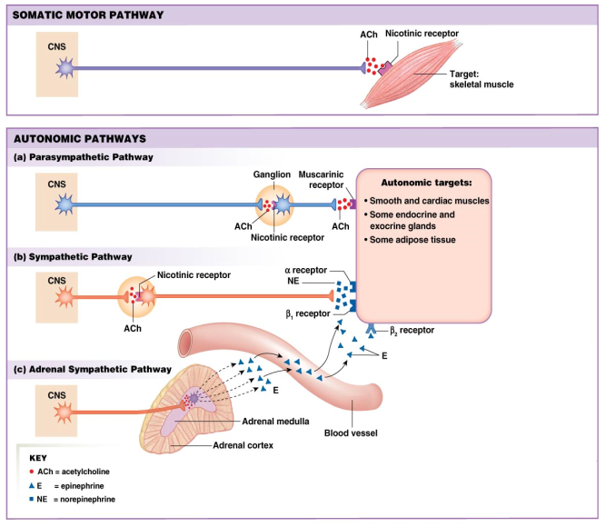
Comparison of Autonomic and Somatic Motor Systems
Somatic
Motor neuron releases Ach directly onto muscle cells/fibers → contraction
Parasympathetic
Preganglionic long, postganglionic short
Preganglionic release Ach
Postganglionic release Ach
Sympathetic
Preganglionic short, postganglionic long
Preganglionic release Ach
Postganglionic release NE
Adrenal gland only has preganglionic, which releases Ach → epinephrine

Slide 40
Sympathetic vs. Parasympathetic
Responses are usually antagonistic
But there are exceptions:
Complimentary effect: saliva production
PNS → stimulate water and enzymes
SNS → stimulate thick mucous
Cooperative effect: sexual function
PNS → induces erection, engorgement and secretions
SNS → Induces ejaculation, stimulates contraction

Slide 41
Parasympathetic vs. Sympathetic
 | Parasympathetic (PSNS) | Sympathetic (SNS)
Preganglionic Neurotransmitter | Acetylcholine | Acetylcholine
Postganglionic Neurotransmitter | Acetylcholine | Norepinephrine
Location of autonomic ganglion? | Close to organ | Close to spinal cord
Innervates adrenal medulla? | No | Yes
When would you observe more activation? | Rest & Digest | Fight & Flight
If activated, what is the effect on heart rate? | Slows heart rate | Increases heart rate
If activated, what is the effect on breathing? | Constricts airways | Relaxes airways
Give an example of an organ/function with antagonistic effect. | Constricts pupils Increases digestion (ie. increases bile secretion, stomach motility increased Increases secretions from pancreas | Dilates pupils Decreases digestion (reduces bile secretions, decreases stomach motility) Decreases secretions from pancreas
Give an example of a cooperative effect. | Genitalia M/induces erection F/engorgement and secretions | Genitalia M/induces ejaculation F/stimulates contractions

Slide 42
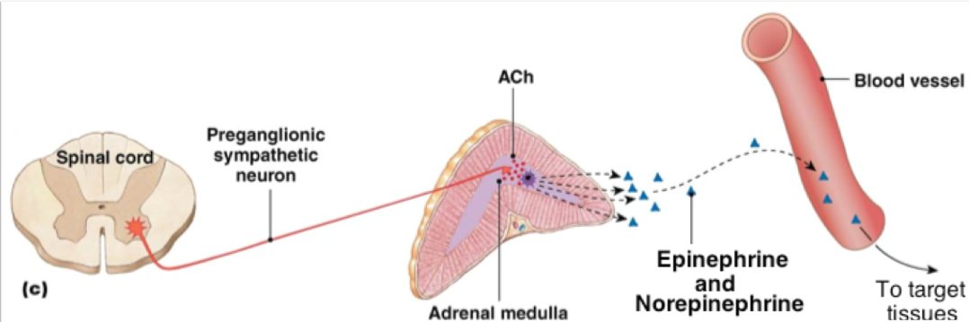
ANS and Adrenal Gland
Outer adrenal cortex releases cortisol
Inner adrenal medulla releases epinephrine and norepinephrine
Sympathetic NS is the only innervation of adrenal by preganglionic neuron
Release Ach into adrenal medulla
Adrenal medulla cells release 80% epinephrine and 20% norepinephrine

Slide 43
Muscle Anatomy
Chapter 6: Professor Stavraky

Slide 44
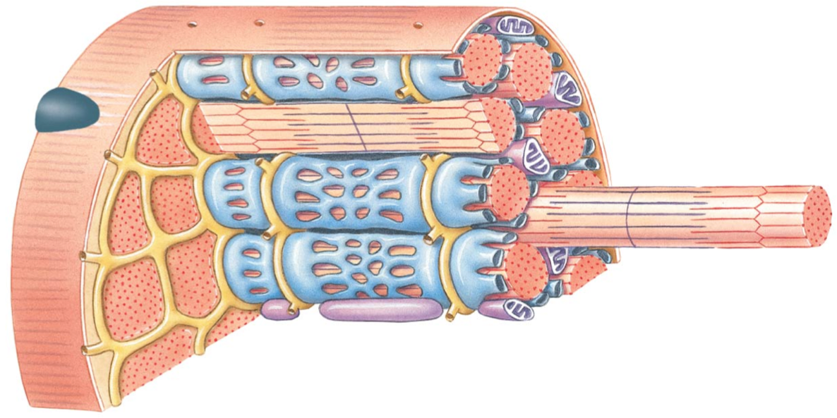
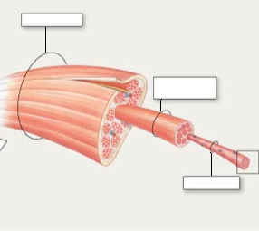
Muscle Structure
Sarcolemma
Whole Muscle
Sarcoplasmic Reticulum
(SR)
Fascicle
Transverse (T) tubules
Lateral Sac
(Terminal Cisternae)
of SR
Muscle Cell/Fiber
Myofibril

Slide 45
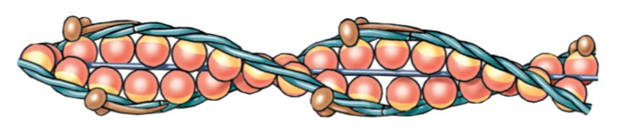
Thin Myofilament
Myosin binding sites
G-Actin
Troponin
Tropomyosin
G-actin: forms alpha-helical chain with other G-actins and contains a myosin binding site
Tropomyosin: in relaxed state, tropomyosin works to cover the myosin binding sites on g-actin
Troponin: attached to tropomyosin and actin to hold tropomyosin over the myosin binding sites in relaxed state

Slide 46
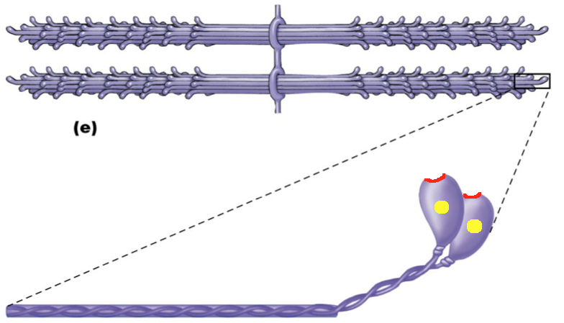
Thick Myofilament
Actin binding sites
Myosin Head
Myosin Tail
ATP binding sites
(ATPase)
Thick filament contains many myosin molecules
Each head has a binding site for Actin and an ATPase
Breaks down ATP into ADP + P_{i} and releases energy for contraction

Slide 47
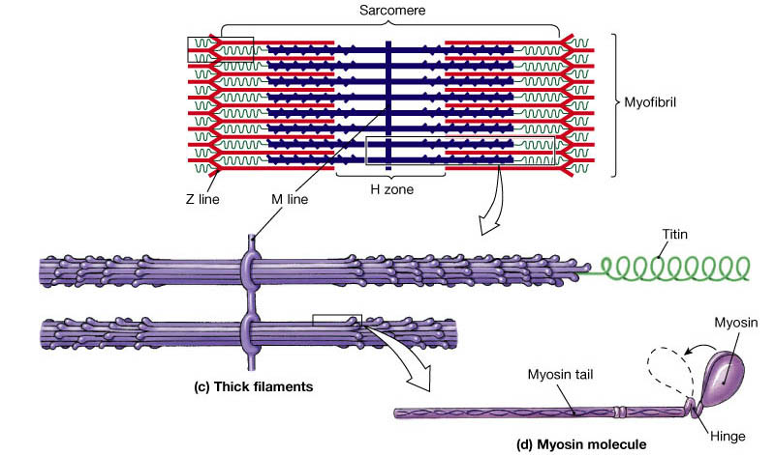
The Sarcomere
Thin Filaments
Thick Filaments
Z-line: where thin myofilaments are joined together
Sarcomere: area between the z-lines, which is smallest functional unit of muscle
Myosin head binds to G-actin on thin filament forming a cross-bridge. A Power Stroke is initiated an a muscle contraction will occur.

Slide 48
The Sliding-Filament Theory
Ca²⁺ binds troponin, causes tropomyosin to roll off and expose myosin binding site
Myosin head binds actin binding site, cross-bridge formation
P_{i} released from myosin head causing power stroke (muscle contraction)
ADP released, myosin still bound to actin until new ATP attached, myosin head detaches (cross-bridge broken)
ATP hydrolyzed to ADP + P_{i}

Slide 49
Next Tutorial (Nov 19th)
Muscle physiology!

Slide 50
What Questions Do You Have?
You can ask in the Owl forums as well!
Also anonymously ask questions in the online dropbox!!

